Slide 1



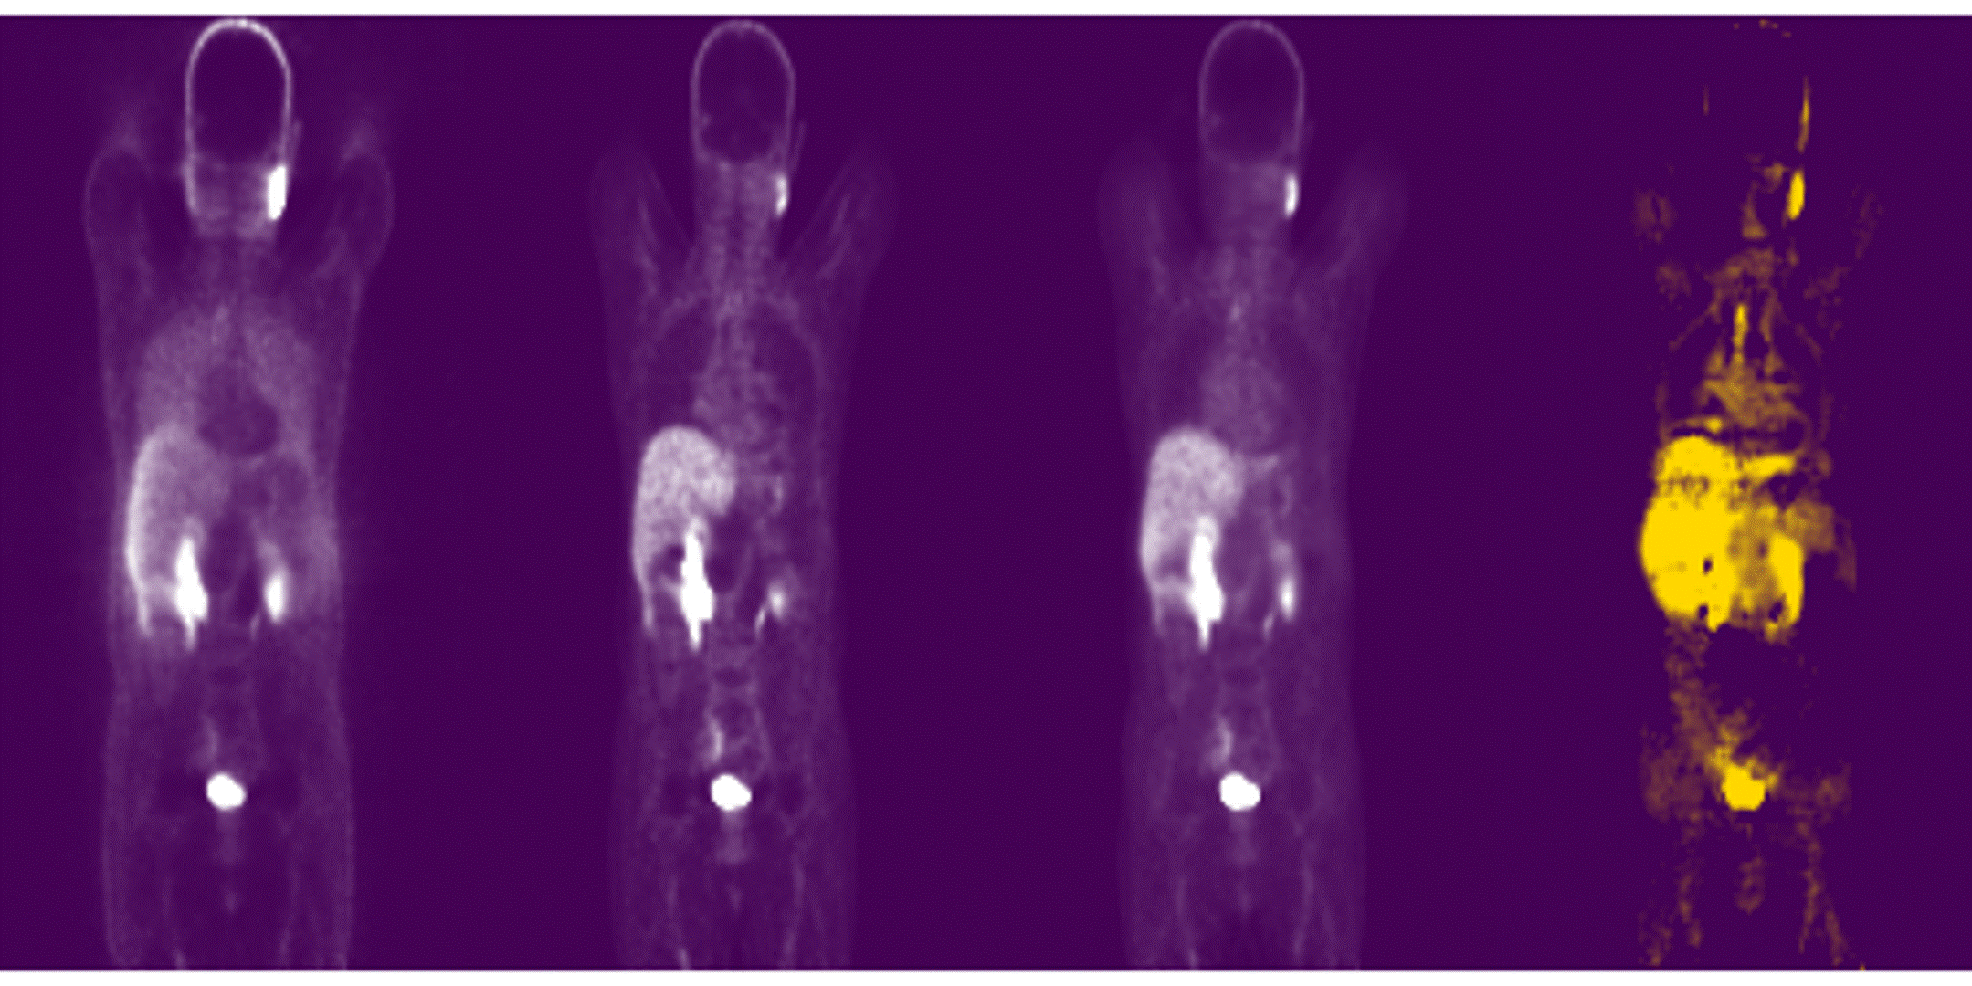

Deep Learning-Based PET Image Correction Toward Quantitative Imaging
Presenter: Sama Shahpouri
Study : Data Science for Life Science
Institute: Hanze University of Applied Sciences
Supervisors: Dr. Isaac Shiri
Assessors: Dr. Dave Landers, Dr. Gijs van derhot
28/08/2024
Notes:
Hello everyone, thank you for joining us today.
I'm Sama Shahpouri, and I'm presenting my thesis titled "Deep Learning-Based PET Image Correction Toward Quantitative Imaging."

Slide 2
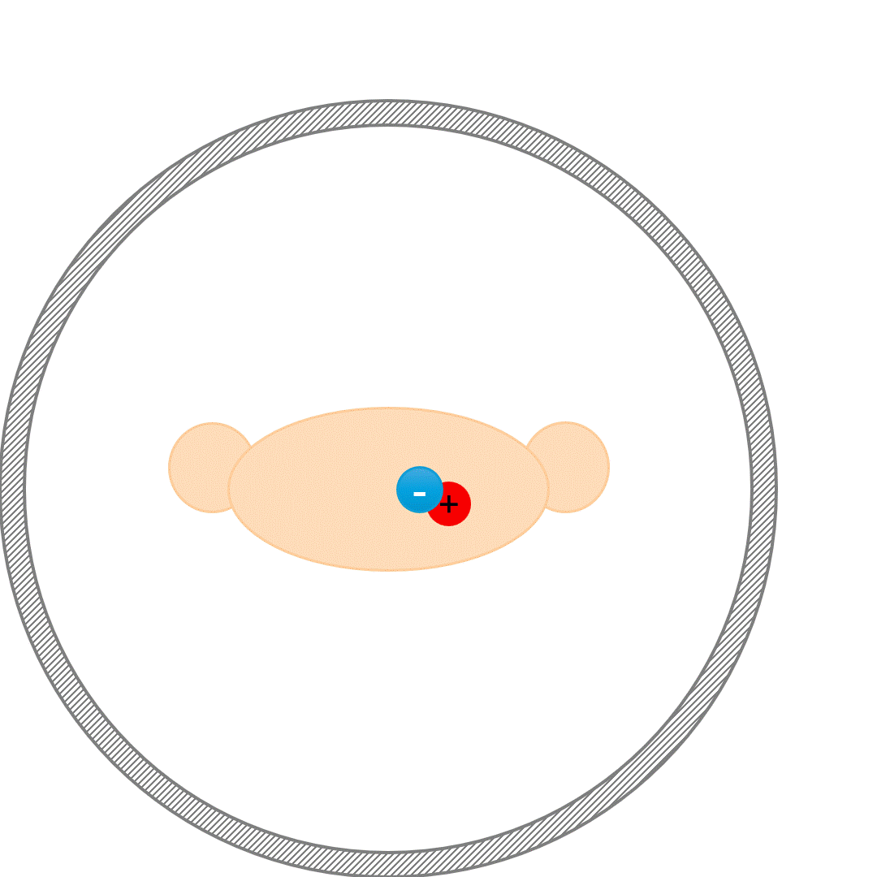
PET Attenuation and Scatter Correction (ASC)
Attenuation correction (AC) of annihilation photons along lines of response (LOR) in the patient body is another critical step
Scatter correction (SC) of Compton scattered photons, which can result in mis-allocation of the annihilated photons, is crucial
Notes:
A PET image is made from a collection of lines of response (LORs), which are formed by detecting pairs of gamma rays emitted as a result of a positron annihilation event.
When a positron of radiotracer interacts with an electron of tissue, they produces two gamma rays in the opposite directions.
If these two gamma rays are detected within a short period of time, we register a true LOR.
This is a True LOR, contributing to the creation of the PET image. However, due to Compton scattering, not all detected events are true coincidences—some are scatter or random events.
To ensure the PET image accurately reflects the tracer distribution, we need to account for and correct these inaccuracies, particularly the effects of attenuation and scatter.

Slide 3
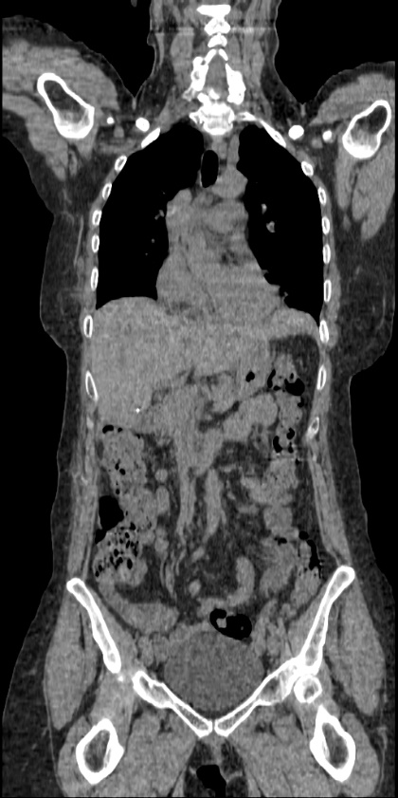
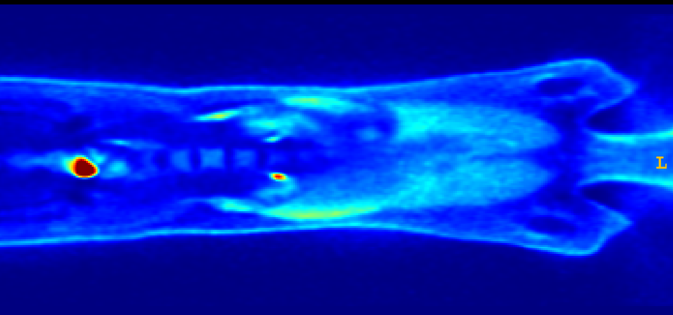
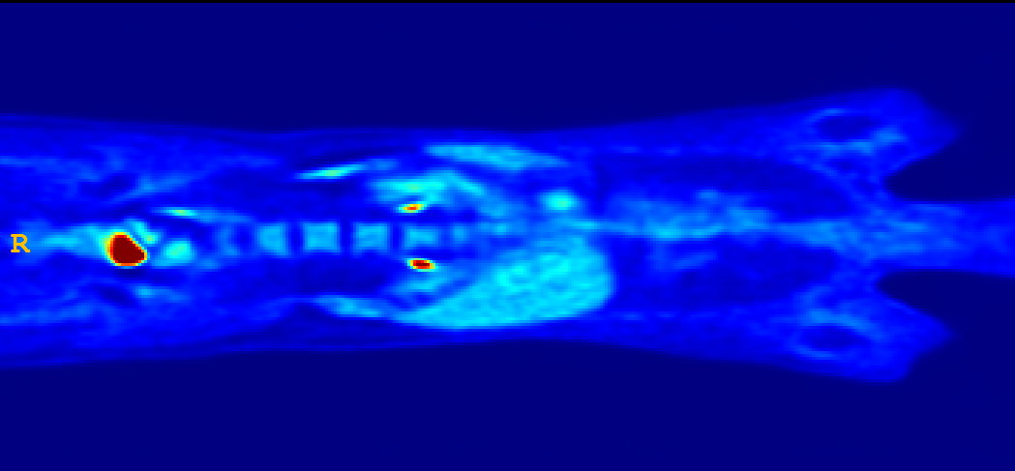
Effects of Attenuation Scatter Correction
Reduced mediastinal
uptake
'Hot' lungs
Non-uniform liver
Enhanced skin uptake
Non-Attenuation Corrected image (NAC) Model-based Attenuation-scatter corrected image(MAC) CT image
Notes:
Around 50 % of the photons detected and used to create images have been scattered at least once along their path. And here you can see some important effect of these scattered photons on the image: Reduced mediastinal uptake, Hot lung, non uniform liver and enhanced skin uptake.
So ASC is the most important necessity must be done for the pet so image will be visually interpretable and quantitatively accurate .

Slide 4
Data flow in a PET/CT scanner [1]
CT Image
X-ray acquisition
Anatomical (CT) Reconstruction
Smooth to PET Resolution
Translate CT to PET Energy (511 keV)
PET Image
PET Emission Acquisition
Attenuation/Scatter Correct PET Emission Data
Functional (PET) Reconstruction
[1] Schmitz et al. The physics of PET/Ct scanners. PET and PET/CT: a clinical guide, 2005.
Notes:
Using the CT attenuation map is one of the regular ways of doing these corrections. For using that, the CT image, should be translated to 511 keV, and the image resolution should be smoothed to match the PET resolution. Then we can use this mu map to correct ASC in pet.

Slide 5
Challenges in ASC using CT info
☢️Radiation Exposure
🚫Limited Availability
💰Cost and Complexity
💉Contrast Agent Issues
🩻 Artifacts
Notes:
But we have some limitations in using CT:
CT scans add exposure to the patients, which can increase the risk of cancer over time.
Not all centers have access to CT devices.
If contrast agents are required for diagnosis, using that CT can be difficult and requires more consideration.
Any misalignment between CT and PET scans can cause artifacts.

Slide 6
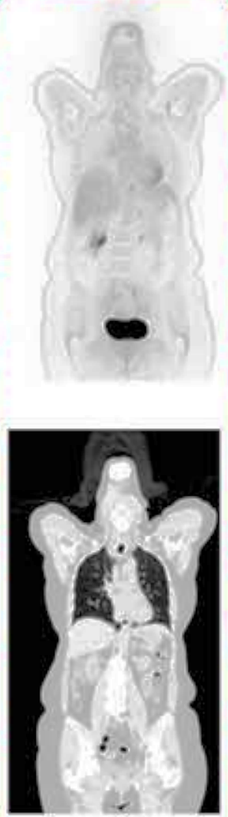
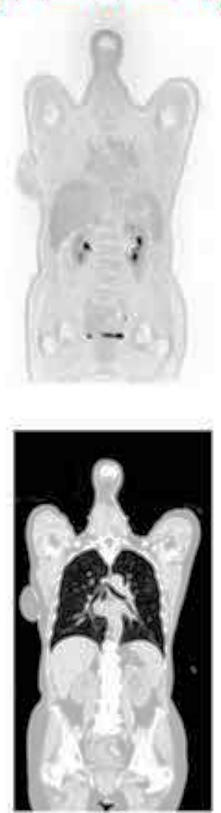
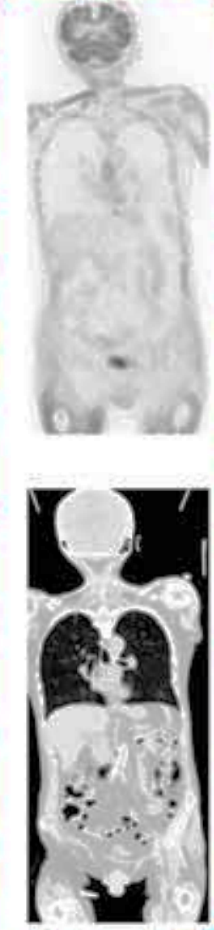
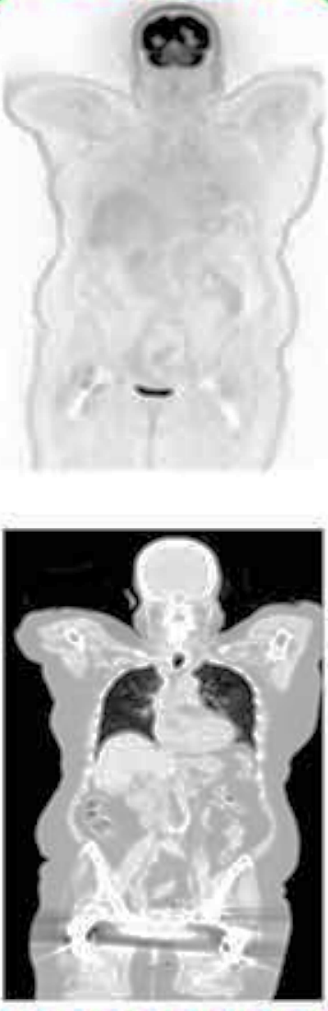
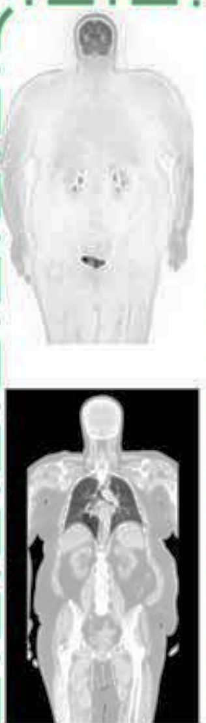
Challenges in ASC using CT info
Halo
Motion
Mismatch
Metal
Truncation
[2] Shiri, Clin Nucl Med. 2023
Notes:
Important artifacts that might occur in PET imaging are shown here.
Some artifacts are related to tracer distribution, such as halo artifacts.
Others are linked to the association between PET and CT/MR images (like motion and mismatch artifacts in different regions),
Or The presence of metal implants can cause streak artifacts in CT images, which affect PET images.
Even, different fields of view between PET and CT can cause truncation artifacts,
particularly in overweight patients or cases with the arms down.

Slide 7
AI is starting to change medical imaging, for real
[3] McMillan, PET Clinic, 2021
Notes:
Since 2016, various deep learning-based methods have been developed for attenuation scatter correction (DL-ASC) in PET imaging. Some of these methods create attenuation maps from MRI or CT images, while others directly generate ASC PET images from NAC images. This direct approach was first used in brain PET imaging and later tested in 18F-FDG PET studies.
Nowadays, there’s more focus on how AI models fit into clinical workflows.
Each center might use slightly different imaging protocols for the same disease, and the imaging devices can vary from place to place. Even Different radiotracers also produce unique image patterns and distributions inside the body. On top of all, not every center has a dedicated AI team, so having a universal model that works everywhere is really appealing.
--------------
One big challenge is that 68Ga-labelled pharmaceuticals tend to produce lower-quality images because they have low tracer activity and a wide positron range, which is not as good as 18F-labelled compounds.

Slide 8
Research Objective
✔️ Address direct ASC of PET images without CT. ✔️ Develop a universal model, for different radiotracers & scanners. ✔️ Evaluate performance in artifact correction
Notes:
First of all,
We focused on direct Attenuation and Scatter Correction (ASC) of PET images without needing CT anatomical data.
Another goal is to create a universal model. This model should work effectively on cross radiotracers and cross scanners with different clinical settings.
Finally, we evaluated how well this model performs in removing artifacts across data from multiple centers.

Slide 9
Materials and Methods

Slide 10
Workflow of A CT-less deep learning network
PET raw data
Direct Model
CT images
Recon without AC & SC
Recon with AC & SC
Recon : reconstruction;
AC : attenuation correction,
SC : scatter correction,
NAC : non-corrected PET,
MAC : CT-Measured attenuation/scatter corrected,
DL PET : deep learning–corrected PET,
NAC (Input)
MAC (Target)
Model Training
DL PET
[4] Guo, Nat Commun. 2022
Notes:
We implement to approach to investigate the performance of model in response of different centers and different tracers.
For direct Model
we used a reconstructed version of our pet data without applying any corrections as the input of our neural network.
And a ct based corrected version of it, as our target or ground truth. From now on we named our imput nac and the target of the model or rather ground truth as mac.

Slide 11
Workflow of A CT-less deep learning network
PET raw data
Semi-Direct Model
CT images
Recon without AC & SC
Recon with AC & SC
NAC (Input)
ADCM (Target)
Anatomy-Dependent Correction Maps
Radiotracer-Dependent textures
Model Training
DL ADCM
[4] Guo, Nat Commun. 2022
Notes:
For semi direct method, we inspire an idea of A recent published article for tackling the issue of different radiotracer distributions inside the body.
It says:
every MAC image carry both anatomical information and radiotracer distribution information,
So if we just train our network on the anatomy-dependent part or ADCM, we can get a model which might be independent from the tracer distribution and it might work for all radiotracer pattern.
We can get dl image from dl adcm by a simple equation we can discuss about it later.

Slide 12
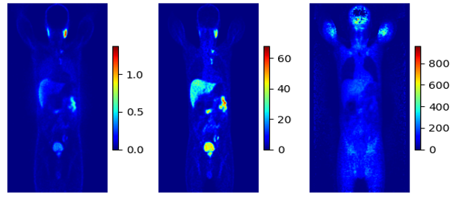
Sample of Input and Ground truths of the network
NAC MAC ADCM
Maximum Intensity Projection of a ⁶⁸Ga PSMA patient.
NAC → non-corrected PET,
MAC → CT-Measured attenuation/scatter corrected,
ADCM → Anatomy-Dependent Correction Maps
Notes:
Here we can see a Maximum Intensity Projection sapmle of input and targets.

Slide 13
⁶⁸Ga PET/CT Dataset
Center | No | Train | Validation | Test | Scanner | Reconstruction | Matrix size × Z*
Center 1 | 56 | 43 | 11 | 2 | Siemens Biograph 6 | 3D-OSEM | 168 × 168
Center 2 | 31 | 25 | 4 | 2 | GE Discovery IQ | 3D-OSEM | 192 × 192
Center 3 | 45 | 35 | 8 | 2 | Siemens mCT | 3D-OSEM | 200 × 200
Center 4 | 40 | 28 | 10 | 2 | Siemens Biograph 6 | 3D-OSEM | 168 × 168
Center 5 | 12 | - | - | 12 | Siemens Horizon | PSF+TOF+3D-OSEM | 180 × 180
Total (%) | 184 | 131 (71%) | 33 (18%) | 20 (11%) | - | - | -
[2] Shiri, Clin Nucl Med, 2023
Notes:
For cross center evaluation, we used A group of 184 patient were selected from a cohort of 1000 patients 68Ga-PSMA PET/CT imaging across five centers.
The table shows acquisition and reconstruction parameters of each center.
We excluded center 5 from the training and validation, as our external test set, and the rest of 4 data wes stertified and used for training, validation and a part of it for internal test set.

Slide 14
¹⁸F-FDG Dataset
Center | No | Train | Validation | Test | Scanner | Reconstruction | Matrix size × Z*
Center 6 | 55 | 39 | 6 | 11 | Siemens Biograph 6 | 3D-OSEM | 168 × 168
Center 7 | 43 | 23 | 9 | 10 | GE Discovery IQ | 3D-OSEM | 192 × 192
Total | 98 | 62 (63%) | 15 (16%) | 21 (21%) | - | - | -
[5] Shiri, Eur J Nucl Med Mol Imaging. 2023
Notes:
And for cross tracer assessment, A total of 98 clean and artifact-free images from two different centers were selected.
As our cross-tracer dataset. 20% of data was selected for test and 65% and 15% were selected for tuning and validation respectively.

Slide 15
Artifact dataset
190 patients
¹⁸Ga PSMA PET/CT
Mostly Motion and Halo artifacts
Notes:
The artifactual images were as our tirth dataset.

Slide 16
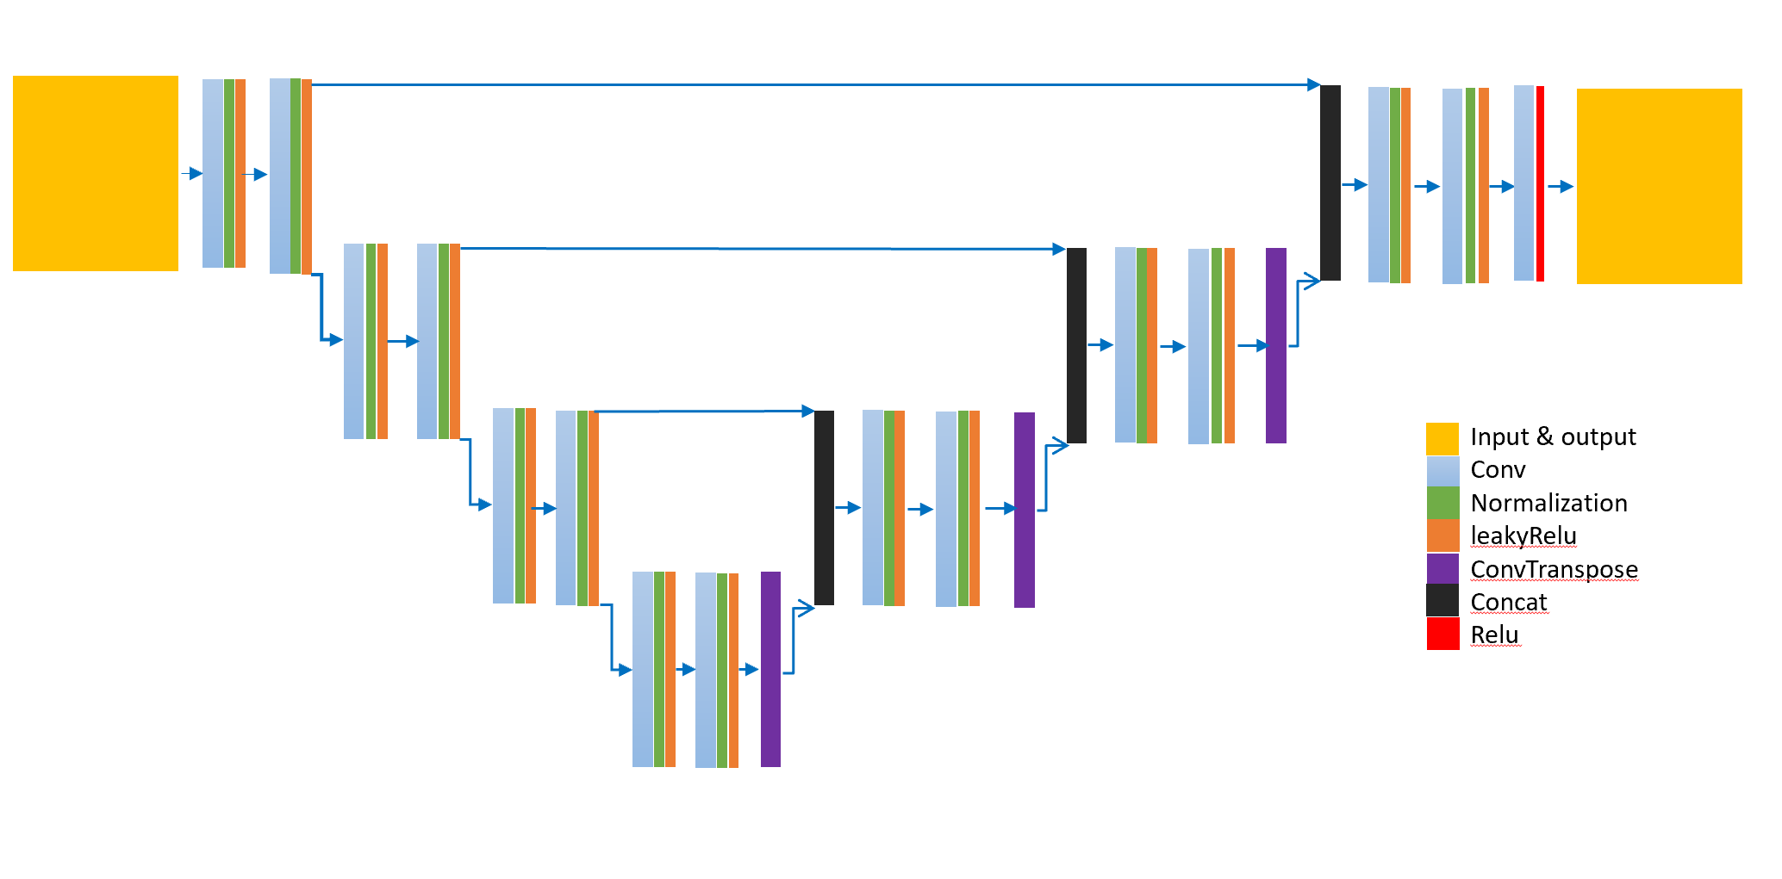
Hyper parameters
Dyn-UNet architecture
3D patches sized 168×168×16
20 patches per patient
Loss function of the mean squared error (MSE)
Learning rate of 0.001
Optimization Adam algorithm
Batch size: 4
spacing : [4.07, 4.07, 3.00]
four layers: [16, 32, 64, 128]
Kernels: [3, 3, 3]
2 super vision head
The architecture of Dyn-Unet used in this research
Notes:
We used unet artitecture. 20 patches of 168, 168 per 16 slices per each patient.
Spacing was picked based on the most frequent spatial resolution of the image.
Batch size based on available resources
Depth of mothel and kernel size was chosen based on patch size and spacing
I used monai library, and models fully trained on train sets.
-----------------------------
which refers to a robust and self-adapting framework on the basis of 2D and 3D vanilla U-Nets nnU-Net, a deep learning framework that condenses the current domain knowledge and autonomously takes the key decisions required to transfer a basic architecture to different datasets and segmentation tasks. Without manual tuning
The function computes the kernel sizes and strides required at each layer of the network to achieve this downsampling, taking into account the original size and spacing of the input data.
def get_kernels_strides(patch_size, spacing): appears to be designed for determining the appropriate kernel sizes and strides
If True, in training mode, the forward function will output not only the final feature map (from output_block), but also the feature maps that come from the intermediate up sample layers.

Slide 17
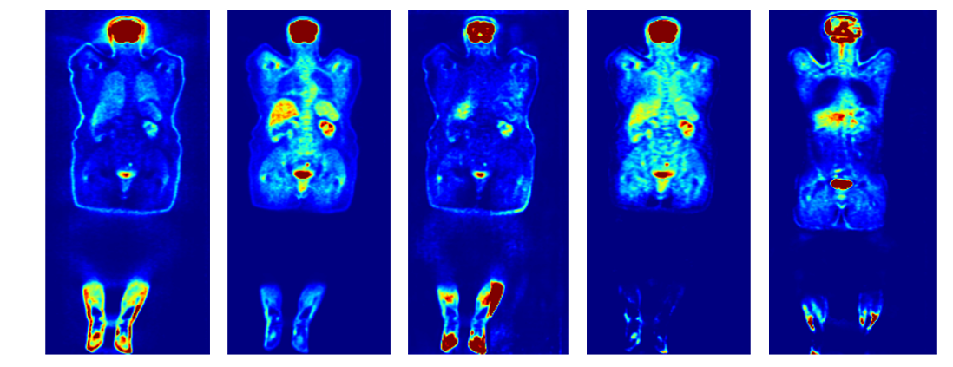
DL Models
NAC MAC IMCM TL - MC ADCM
⁶⁸Ga-PET
IMCM
ADCM
¹⁸F-FDG
TL-MC
ADCM
A sample of maximum intensity projection of ¹⁸F-FDG test set. IMCM does not respond to cross tracer data, need to be tuned.
IMCM → Integrated multi-Centre model, loss: 0.0527 at epoch 434.
ADCM → Anatomy-Dependent Correction Model, loss: 0.1237 at epoch 466.
TL-MC → Transfer Learning for IMCM model, loss: 0.0014 achieved at epoch 10.
Notes:
For cross center evaluation we train our network on Ga dataset and we named it IMCM.
We also tried ADCM model on this dataset.
For cross tracer essessment, we tuned IMCM on fdg dataset and named it TL-MC.
As we discuse ADCM was also tested on the fdg dataset without any tuning or changing in the waites of the model.

Slide 18
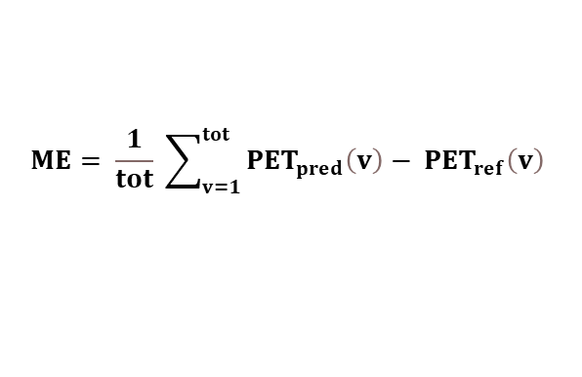
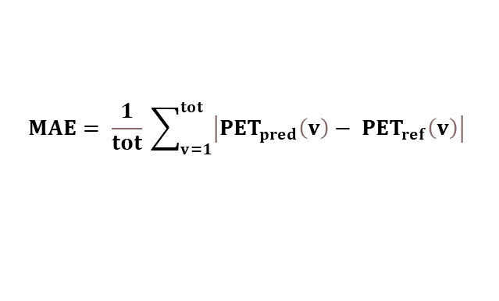
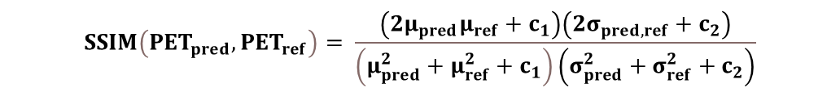
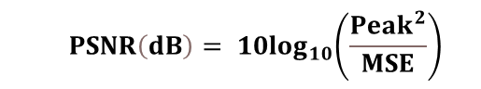
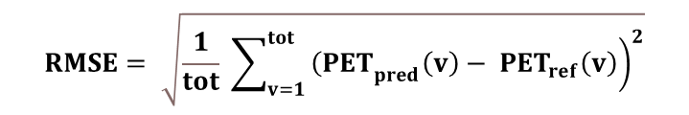
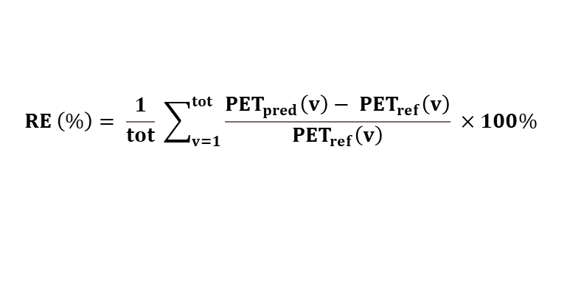
Quantitative analysis
$$ME= \frac{1}{tot} \sum_{v=1}^{tot}{{PET}_{pred}\left(v\right)− {PET}_{ref}\left(v\right) }$$
$$MAE= \frac{1}{tot} \sum_{v=1}^{tot}{\left|{PET}_{pred}\left(v\right)− {PET}_{ref}\left(v\right)\right| }$$
$$RE \left(\%\right)= \frac{1}{tot} \sum_{v=1}^{tot}{\frac{{PET}_{pred}\left(v\right)− {PET}_{ref}\left(v\right)}{{PET}_{ref}\left(v\right)} ×100\% }$$
$$RMSE= \sqrt{\frac{1}{tot} \sum_{v=1}^{tot}{{\left.{\left(PET\right.}_{pred}\left(v\right)− {PET}_{ref}\left(v\right)\right)}^{2}}}$$
$${ PSNR\left(dB\right)= 10log}_{10}\left(\frac{{Peak}^{2}}{MSE}\right)$$
$$SSIM\left({PET}_{pred},{PET}_{ref}\right)= \frac{\left(2μ_{pred}μ_{ref}+c_{1}\right)\left(2σ_{pred,ref}+c_{2}\right)}{\left(μ_{pred}^{2}+μ_{ref}^{2}+c_{1}\right)\left(σ_{pred}^{2}+σ_{ref}^{2}+c_{2}\right)}$$
Notes:
The performance of the trained network in dl pet images is evaluated
Using these various metrics that compare the model’s outcome to the reference
from the same patient.
The metrics we use were:
Mean Error (ME),
Mean Absolute Error (MAE): is the average of the absolute differences between predicted and reference values
Relative Error (RE%):
Root Mean Squared Error (RMSE):
Peak Signal-to-Noise Ratio (PSNR):
measures the ratio between the maximum possible value and the magnitude of the error,
structural similarity index:
SSIndex evaluates the general similarity between the predicted and reference images, focusing on perceptual quality rather than just pixel differences
index has a scale between −1 to 1, where an SSIM
1 represents a perfect recovery of the original image..
------------------------
Mean Error, Mean Error (ME):
Represents the average difference between predicted and reference values
Mean Absolute Error (MAE):
This is the average of the absolute differences between predicted and reference values, giving a sense of overall prediction accuracy without considering the direction of the error.
Relative Error (RE%):
Shows the error as a percentage of the reference value, providing a normalized way to compare errors across different scales.
Root Mean Squared Error (RMSE):
RMSE is a measure of the square root of the average squared difference between the
Two pet images for each voxel : has the usit as same as the imge, so it is suv.
Combines both the magnitude and variance of the errors, penalizing larger errors more than smaller ones. It's particularly useful for highlighting large deviations in predictions.
Peak Signal-to-Noise Ratio (PSNR):
measures the ratio between the maximum possible value and the magnitude of the error, providing an indication of the overall quality of the predictions relative to the reference.
PSNR is a measure of relative power of the relative difference or noise in an image
compared to its reference
structural similarity
SSIM evaluates the structural similarity between the predicted and reference images, focusing on perceptual quality rather than just pixel differences
index has a scale between −1 to 1, where an SSIM
1 represents a perfect recovery of the original image..
-----------------------------------------------
MAE is similar to the RMSE except that it is the absolute error rather than the squared error
as calculated using the following equation
MAE also yields error in units that match the original image
. One limitation of the MAE
approach is that if errors are centered around zero, the values of MAE may be much smaller
than RMSE. Both RMSE and MAE can be sensitive to the cropping of the images: if images
contain large amounts of surrounding air, this can have the effect of decreasing the average
error, as models can often predict surrounding air with near perfect accuracy.

Slide 19
Results

Slide 20
⁶⁸Ga-PET
IMCM → Integrated multi-Centre model ADCM → Anatomy-Dependent Correction Modeh
Notes:
IMCM represent lower mean errors compared to ADCM for all 4 error matrics both in external and internal test set.
Both models show higher errors in deal with external center, but ADCM has a slightly higher MAE and RMSE with a larger spread.
SSIM Also, IMCM achieves higher SSIM, showing better image quality.
Overall, IMCM outperforms ADCM in most metrics, providing more reliable and higher quality images.

Slide 21
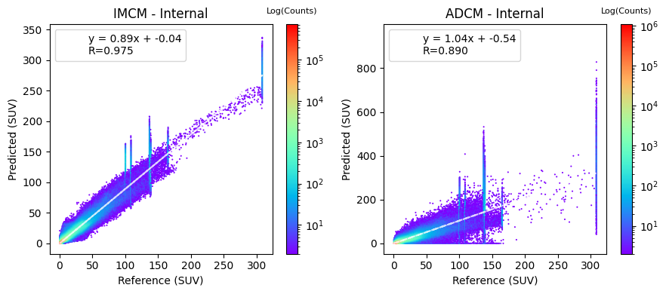
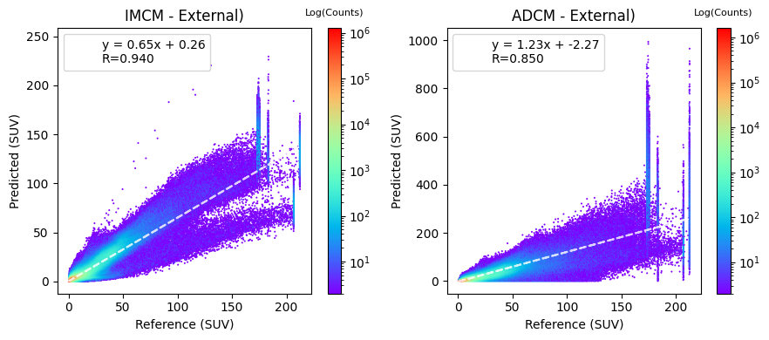
⁶⁸Ga-PET
IMCM → Integrated multi-Centre model ADCM → Anatomy-Dependent Correction Modeh
Notes:
The joint histogram shows the voxel-wise correlation for predicted values compared to the reference ones.
Top left: the comparison for the IMCM model within internal centers.
(Bottom Left):shows the comparison for the IMCM model within external centers (C5).
The slope (0.65) is less than 1, indicating significant underestimation of predicted values compared to the reference.
The intercept (0.26) shows a slight positive bias.
But The R-value (0.940) suggests a good linear relationship.
(Top Right): shows adcm in responding to internal test set;
The slope (1.04) is slightly greater than 1/
The intercept (0.54) suggests a minor positive bias.
The R-value (0.890) is lower than that of IMCM, indicating a weaker linear relationship.
ADCM - External (Bottom Right):
The slope (1.23) is much greater than 1,.
The intercept (-2.27) indicates a negative bias.
The R-value (0.850) is the lowest among all panels, indicating the weakest linear relationship.
General Observations:
IMCM generally shows less deviation from the reference values compared to ADCM, both in internal and external cases with sign of underestimation.
ADCM tends to overestimate SUV values more than IMCM, especially in external centers. indicating a notable overestimation of predicted values
-------------------------------------------------
General Observations:
Both models (IMCM and ADCM) perform better (closer to the ideal line) in internal centers compared to external centers.
The differences between predicted and reference values are more pronounced in the external centers, with ADCM showing greater deviation compared to IMCM.
IMCM vs. ADCM:
IMCM generally shows less deviation from the reference values compared to ADCM, both in internal and external cases.
ADCM tends to overestimate SUV values more than IMCM, especially in external centers.
The plots suggest that the IMCM model performs more reliably across both internal and external centers compared to the ADCM model, which shows more significant deviations, especially in external cases. The color intensity distribution indicates where most of the data points are concentrated, helping visualize the density of SUV predictions relative to the reference values.

Slide 22
¹⁸F-FDG
ADCM → Anatomy-Dependent Correction Model TL-MC → Transfer Learning for IMCM model
Notes:
In cross tracer validation
TL-MC generally shows lower and more consistent errors compared to ADCM,
ADCM shows more stability and constant parameters regarding TL-MC in terms of ssim and psnr.
-------------------------------------------------------------------------------------------------------------------

Slide 23
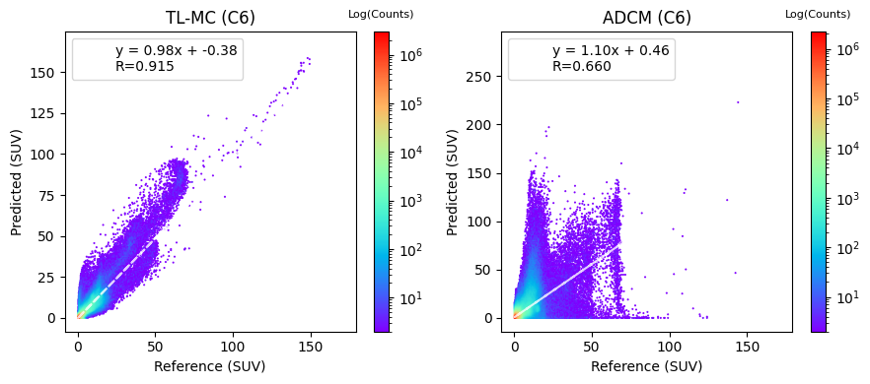
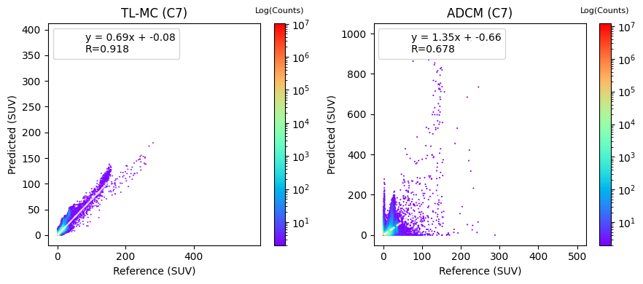
¹⁸F-FDG
ADCM → Anatomy-Dependent Correction Model TL-MC → Transfer Learning for IMCM model
Notes:
The TL-MC shows better performance across both centers compared to the ADCM model. by higher correlation coefficients and R values.
----------------
the ADCM model shows noticeable variability and tends to overestimate SUVs,
particularly in the higher range,

Slide 24
Artifact Detection & Correction

Slide 25
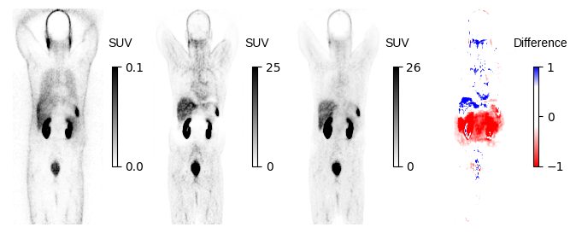
Halo artifact in kidney
Notes:
Here you can see the coronal views, showing from left to right:, non-ASC, CT-ASC, DL version, and the difference between mac and dl.
As shown here IMCM successfully removed the halo artifacts in the kidney region

Slide 26
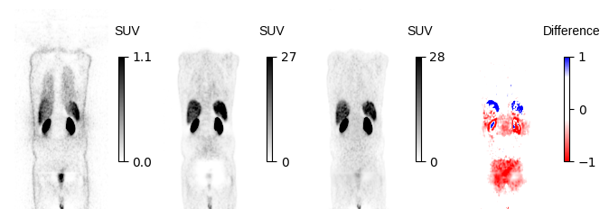
Halo artifact in pelvic
Notes:
Here we see how well IMCM model compensate the halo artifact in pelvic area.

Slide 27
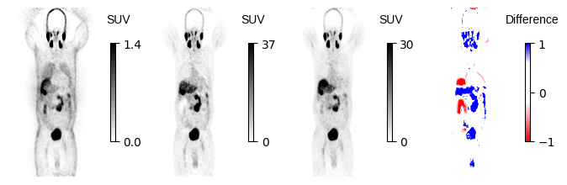
Motion & Halo Artifact

Slide 28
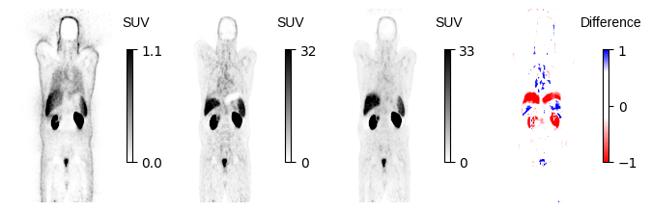
Motion artifact

Slide 29
Discussion
🗨️ Developed a CT-free DL models for ASC in PET imaging,
🗨️ Tested across different centers and radiotracers.
🗨️ For cross-center data, IMCM outperformed ADCM.
🗨️ Regarding cross-tracer data, TL-MC obviously follows the regression line.
Notes:
So in this research, we Developed two CT-free DL models for ASC in PET imaging,
We tested models in face with different centers and radiotracers.
In cross center evaluation, we saw IMCM outperformed ADCM, it demonstrated less error and higher similarity to the reference image.
Both models works for external data, but ADCM’s performance drops, particularly in maintaining image quality, as been shown by the larger errors and lower PSNR and SSIM values.
in joint histogram evaluation, TL-MC obviously follows the regression line better than ADCM.
ADCM did not show good performance to predict suvs relible.
By successfully removing artifacts, model is improving, image quality and diagnostic confidence, which is important for both initial diagnosis and follow-up studies.

Slide 30
Limitations
🧱 Challenged to preserve quantification characteristic of ADCM images,
due to facing with high value.
🧱Single universal models may not be effective;
radioisotope-specific tuning is necessary.
🧱 Limited access to computational resources
caused time consuming each training loop.
Notes:
We faced a few challenges during our work on this project:
Making ADCM images with suv unit and normalization , was tricky, Because we sometimes had to divide by very small numbers, we ended up with some really large values that weren’t suitable for training the model. This created challenges for us during normalization.
Using a single universal model in this context? It seems Not so effective for cross tracer. We found that radioisotope-specific tuning is really necessary to get the best results.
On top of that, limited access to computational servers made our training loops take forever. So yeah, it was a big issue for me.

Slide 31
📍 Train and test the model for more data from other centers.
📍 Assess the model organ-wise.
📍 Explore more Clinical Imaging Parameters.
📍 Targeted analysis for artifactual images.
📍 More statistical testing of artifact correction.
📍 Investigate other Neural Networks.
Future Work
Notes:
"So, here’s what we’re thinking about for the next steps:
First off, we want to expand our training and testing by including more data from other centers. This will help us ensure that the model generalizes well across different settings.
Assessing the model organ-wise is another big priority. By looking at how well it performs on different organs, we can tailor it more specifically to clinical needs.
We’re also planning to dive deeper into clinical imaging parameters like SUVmean, SUVmax, and SUVpea.
More statistical testing for artifactual data, as we do not have good ground truth, we can score them by human observers
We’re also interested in investigating other types of neural networks

Slide 32
🔍 Designed a network to directly performs ASC from raw data.
minimizing vulnerabilities related to pseudo-CT synthesis challenges.
🔍 Preformed well in different centers.
making it reliable and flexible for use in clinics.
🔍 Addressed artifact challenges effectively.
showcasing a high capability in detecting and removing artifacts in PET scans
🔍 Constructed a quality control method
to not only detect but to also overcome those artifacts.
🔍 Applicable where only Stand-alone PET
or PET/MRI systems are available.
🔍 Reduced in the cumulative radiation dose
would be valuable, particularly the paediatrics population
Conclusion
Notes:
“So, let's talk about what we've accomplished on this research.
Directly performs ASC from emission data which applicable in settings where only PET-only scanners and PET/MRI systems are available.
We observed that a multi-center model can respond well in different image acquisition/reconstruction settings. But it needs to be tuned for different radiotracer distribution.
We showed by comparison of these images that several artifacts can be readily revealed, enabling a fast and feasible quality assurance method to not only detect but to also overcome those artifacts.
🔍 Another important point is the reduction in cumulative radiation dose. This is particularly valuable in pediatric settings, where minimizing radiation exposure is crucial for patient safety.

Slide 33
Auto – Dashboard for ASC
Click on DL ASC PET App
Notes:
I have developed a dashboard that enables real-time attenuation and scatter correction (ASC) .
The dashboard allows users to process data instantly and assess the effectiveness of the model on the fly
002360_C2_IM_
004126_C4_SH_ last one

Slide 34
References
[1] Schmitz et al. The physics of PET/Ct scanners. PET and PET/CT: a clinical guide, 2005.
[2] Shiri I, Salimi Y, Hervier E, Pezzoni A, Sanaat A, Mostafaei S, et al. Artificial Intelligence-Driven Single-Shot PET Image Artifact Detection and Disentanglement: Toward Routine Clinical Image Quality Assurance. Clin Nucl Med. 2023 Dec 1;48(12):1035–46
[3] McMillan, A. B., & Bradshaw, T. J. (2021). Artificial Intelligence-Based Data Corrections for Attenuation and Scatter in Position Emission Tomography and Single-Photon Emission Computed Tomography. PET clinics, 16(4), 543–552.
[4] Guo R, Xue S, Hu J, Sari H, Mingels C, Zeimpekis K, et al. Using domain knowledge for robust and generalizable deep learning-based CT-free PET attenuation and scatter correction. Nat Commun. 2022 Dec 1;13(1). [5] Shiri I, Salimi Y, Maghsudi M, Jenabi E, Harsini S, Razeghi B, et al. Differential privacy preserved federated transfer learning for multi-institutional 68Ga-PET image artefact detection and disentanglement. Eur J Nucl Med Mol Imaging. 2023;

Slide 35

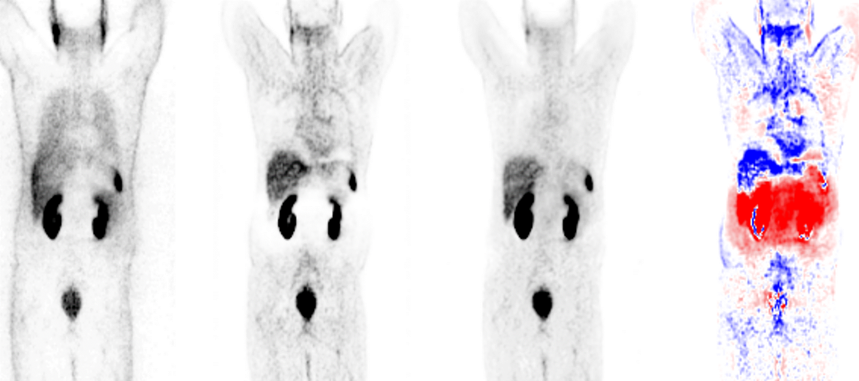
Notes:
I want to give a big thanks to my supervisor, Dr. Shiri. I’ve learned so much from you, and I hope we will publish the article together soon. Your support and guidance have meant so much to me.
And to the love of my life, thank you for always being there and cheering me on. I couldn’t have done this without you.
Thank you to everyone who brightened my path in this journey!

Slide 36
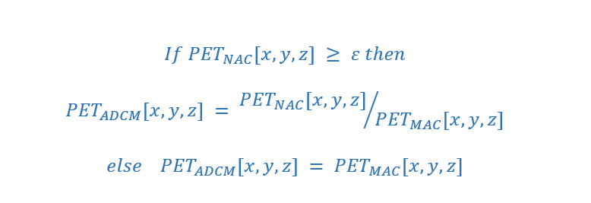
Workflow of Decomposition-Based Approach [1]
NAC (Input)
MAC (Target)
Anatomy-Dependent Correction Maps (ADCM)
Model Training
Anatomy-independent textures
DL PET
[3] Guo, Nat Commun. 2022

Slide 37
Workflow of Decomposition-Based Approach [1]
NAC (Input)
ADCM
Anatomy-Dependent Correction Maps (ADCM)
Model Training
Anatomy-independent textures
DL PET
[3] Guo, Nat Commun. 2022

Slide 38
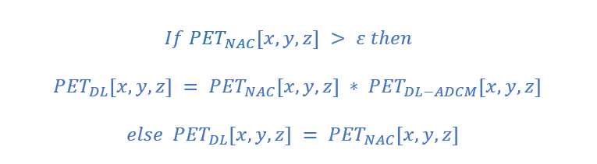
Workflow of Decomposition-Based Approach [1]
NAC (Input)
ADCM
Model Training
DL ADCM
DL PET
[2] Guo, Nat Commun. 2022

Slide 39
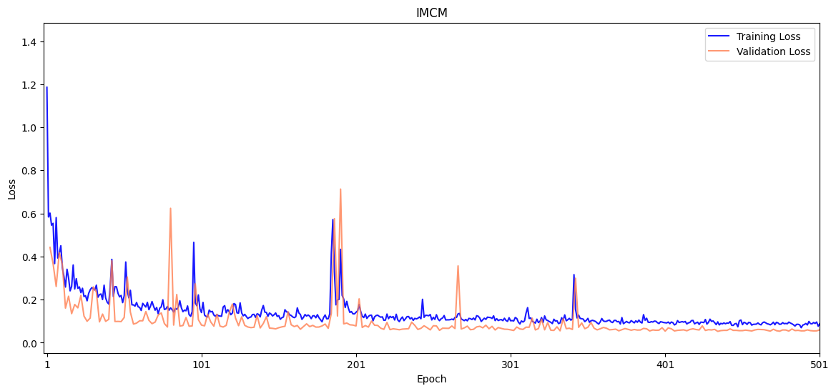
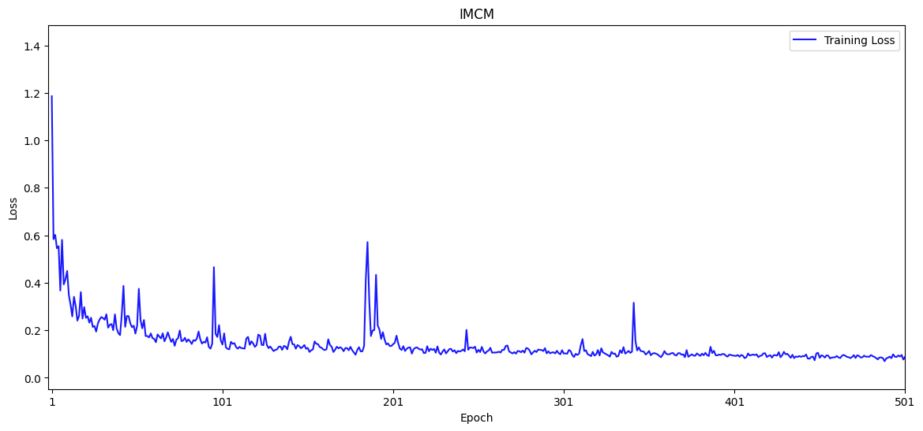
⁶⁸Ga-PET
Integrated multi-Centre model (IMCM): the best metric of 0.0527 at epoch 434.

Slide 40
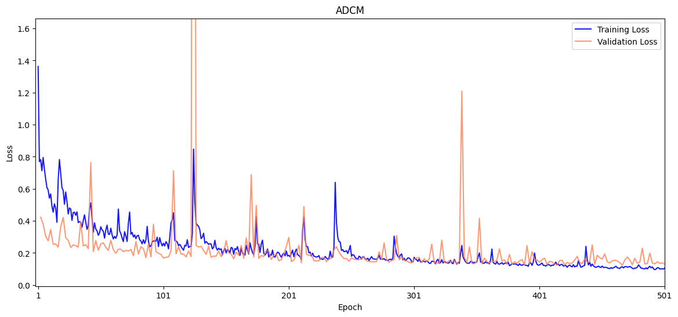
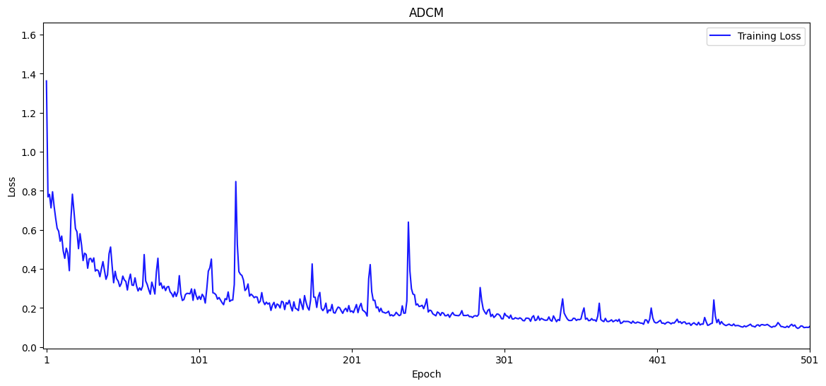
⁶⁸Ga-PET
Anatomy-Dependent Correction Model (ADCM): the best metric of 0.1237 was reached at epoch 466.

Slide 41
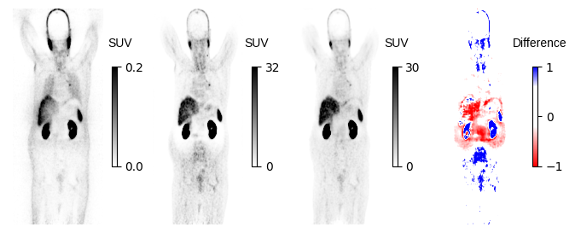
Motion and Halo

Slide 42
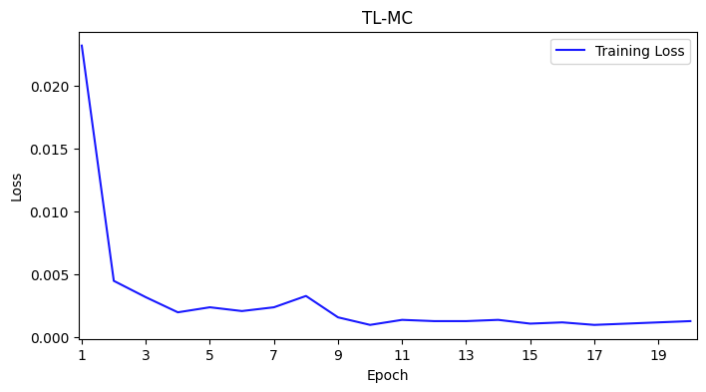
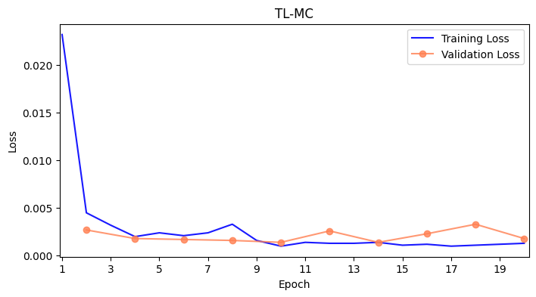
¹⁸F-FDG
Transfer Learning for IMCM model (TL-MC): Training and validation loss for the Tune TL Model with a best metric of 0.0014 achieved at epoch

Slide 43
⁶⁸Ga-PET

Slide 44
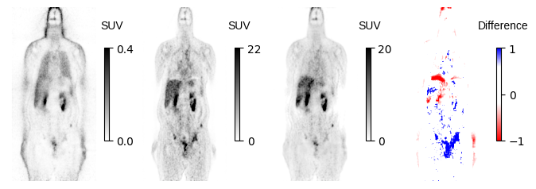
Motion Artifact

Slide 45
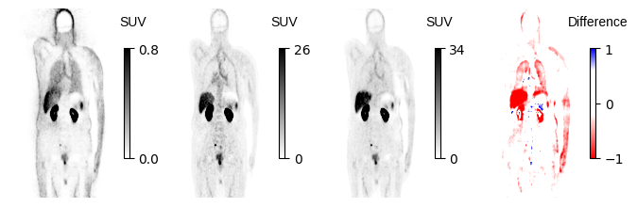
Truncation and Motion

Slide 46
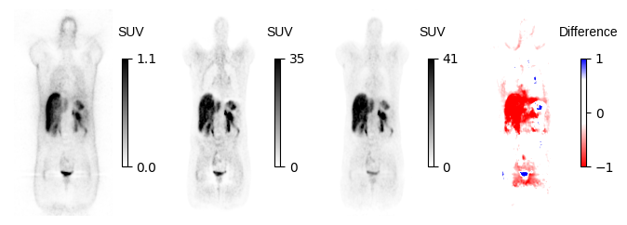
Halo

Slide 47
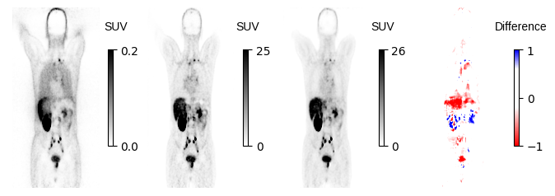
Motion Artifact

Slide 48
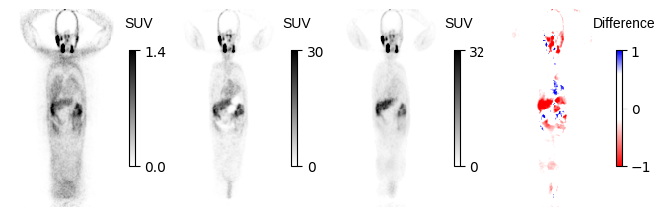
Metal artifact

Slide 49
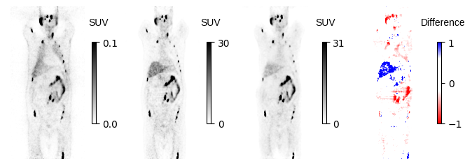
Motion Artifact???

Slide 50
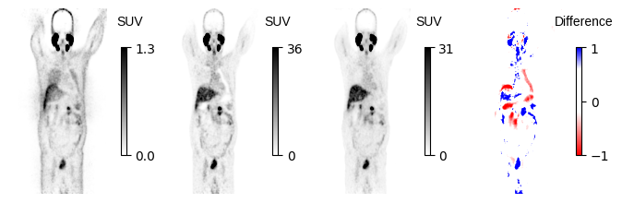
???

Slide 51



